Slide 1

Wear′s the Party!
Paul Lammertsma
CTO, Pixplicity

Slide 2
Wear’s the Party!
Paul Lammertsma
CTO, Pixplicity

Slide 3
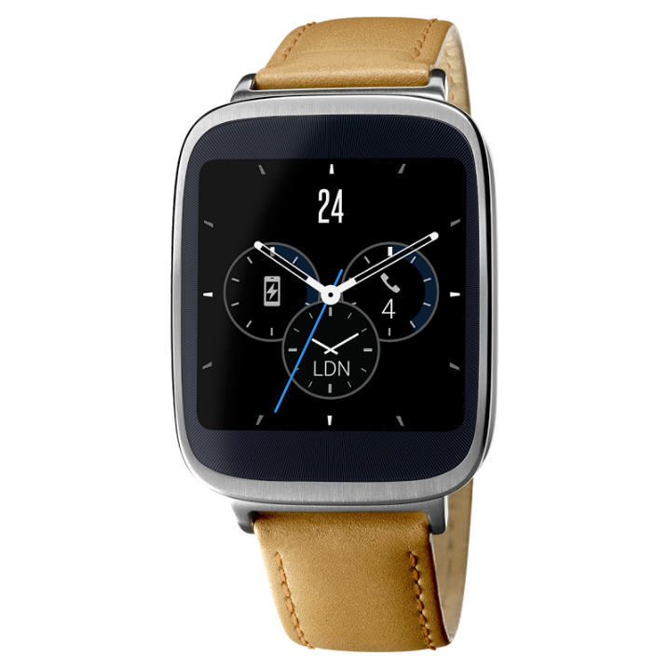
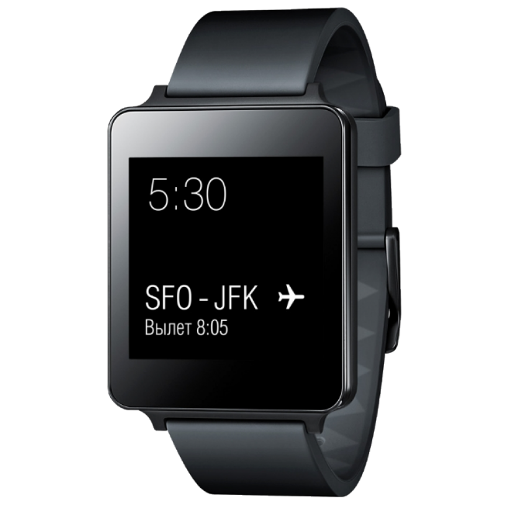
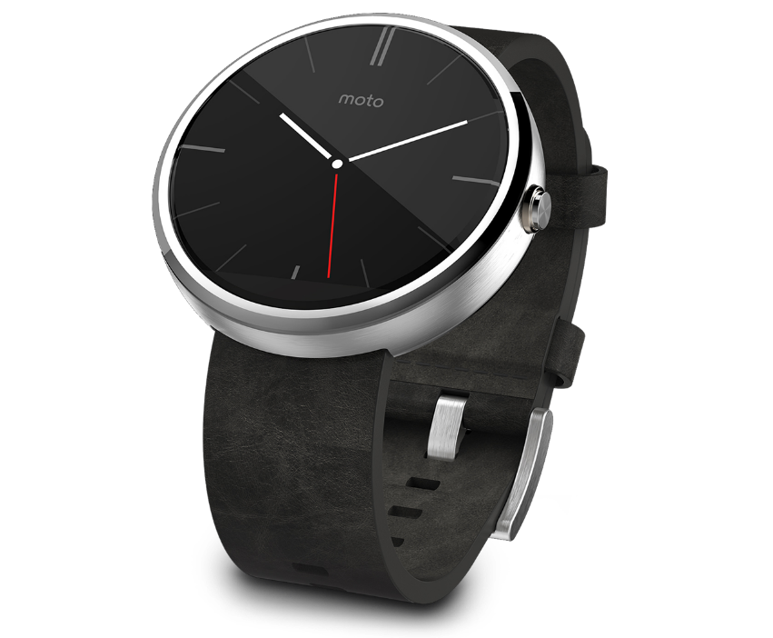
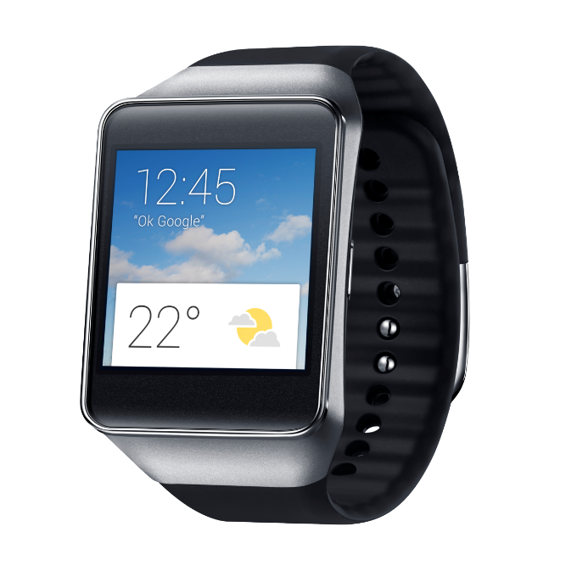
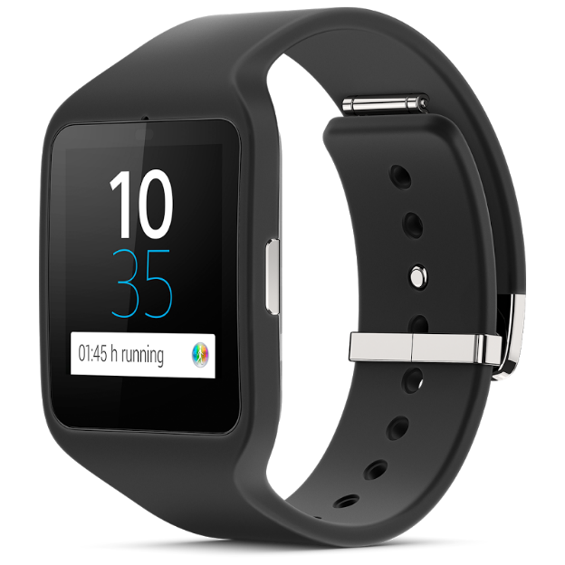
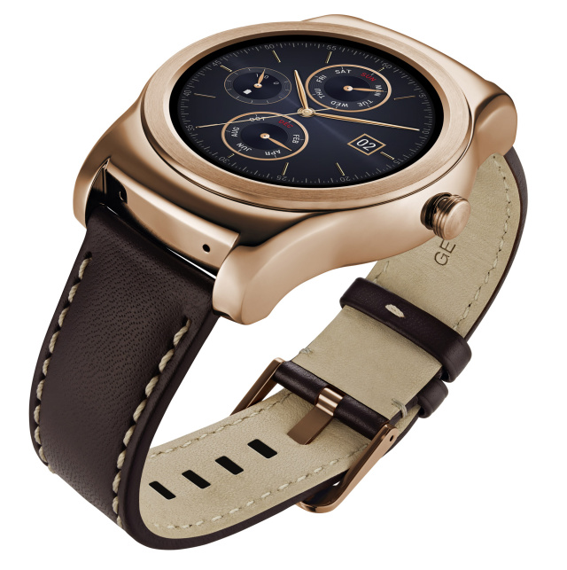
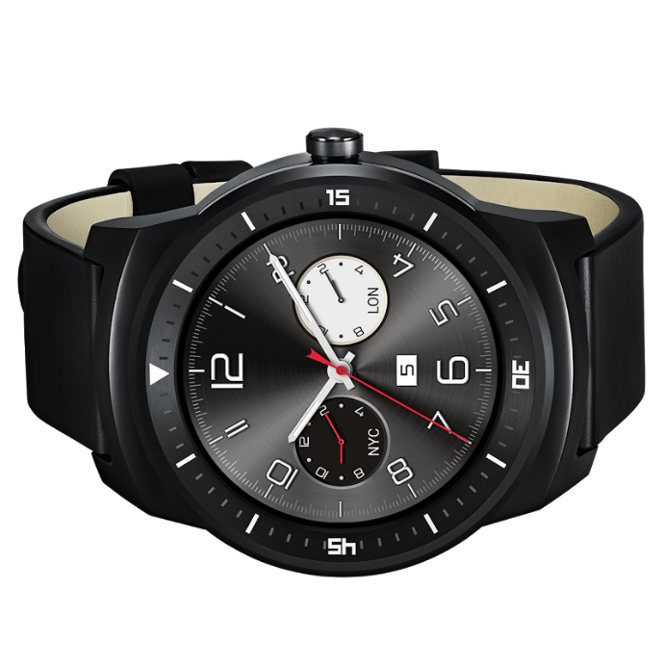
Notes:
The party started in March 2014.
Left to right: Sony Smartwatch 3, Samsung Gear Live, Asus Zenwatch, LG G Watch, LG Watch Urbane, Motorola Moto 360, (front) LG G Watch R

Slide 4
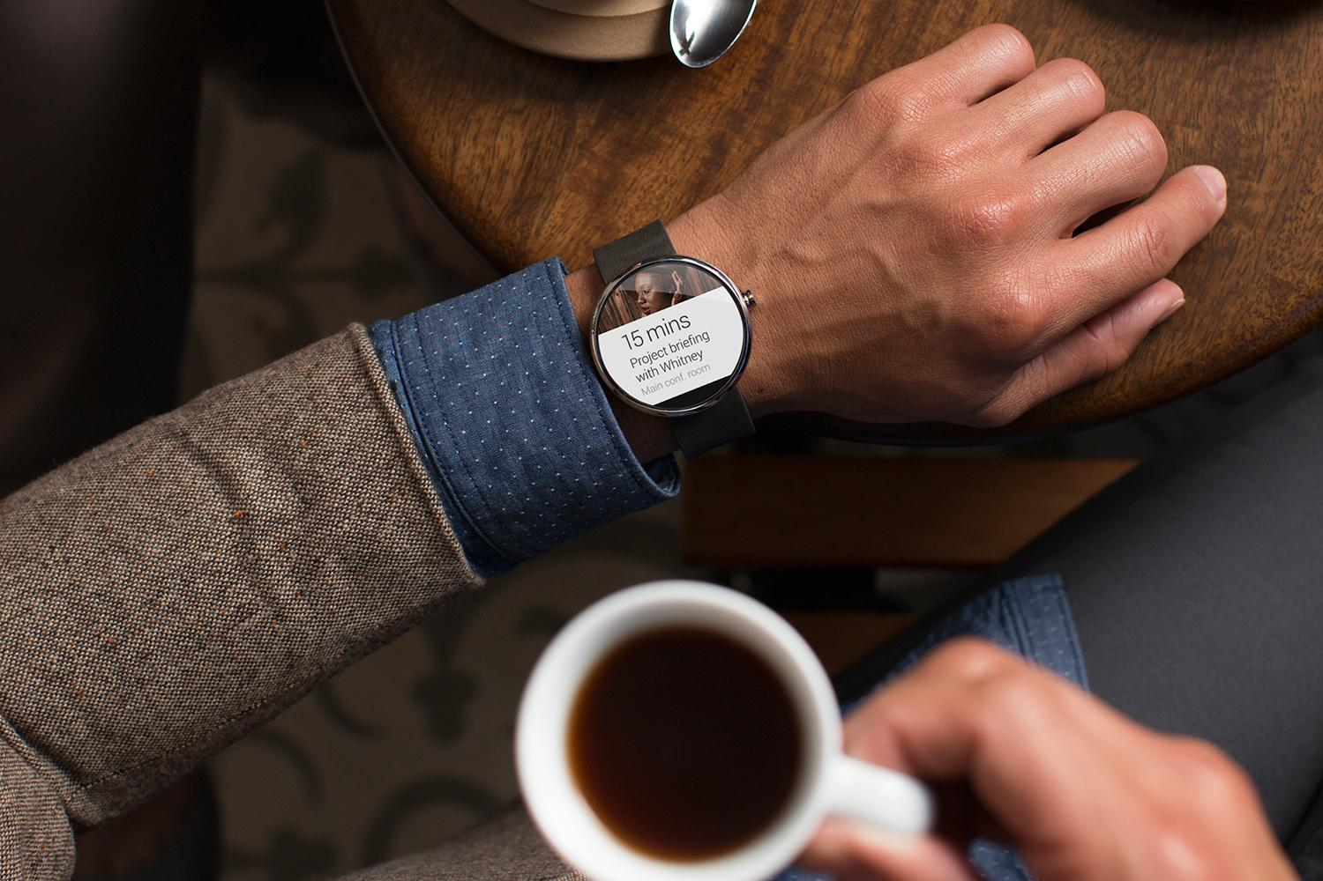
Short demo

Slide 5
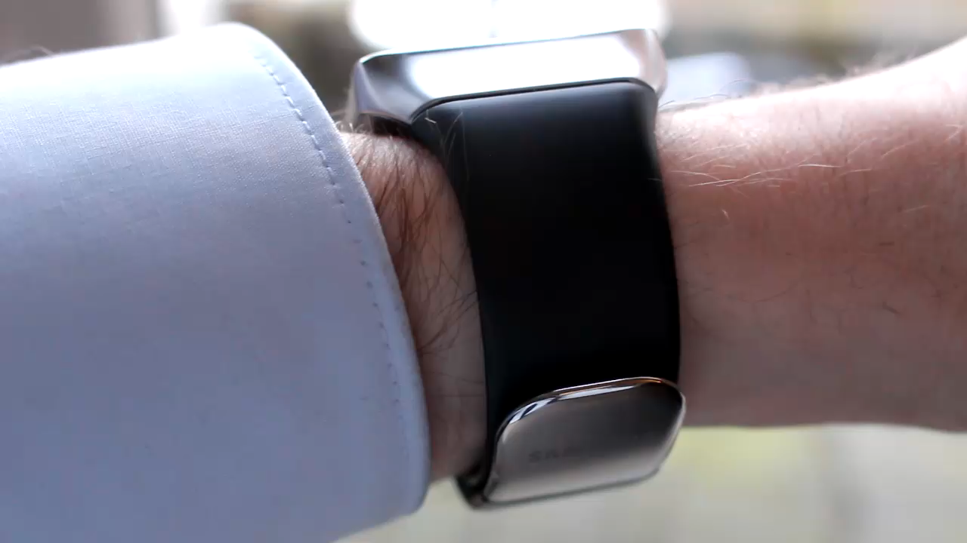

Slide 6
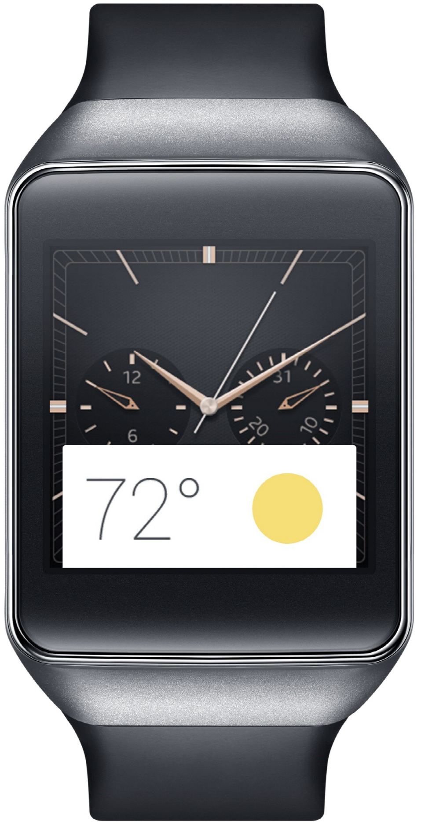
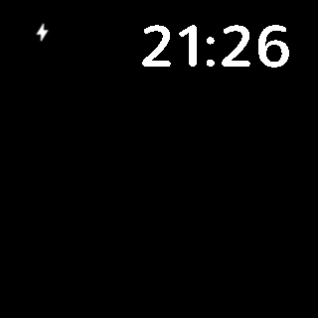

Slide 7
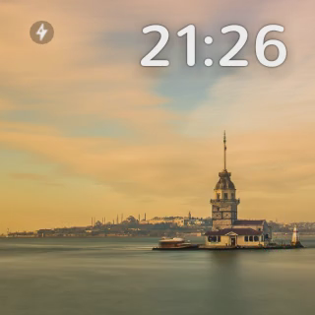

Slide 8
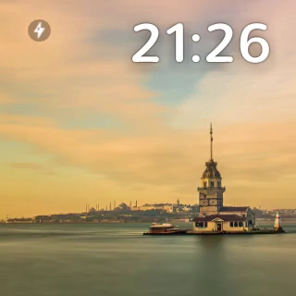

Slide 10
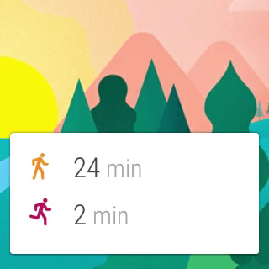

Slide 11
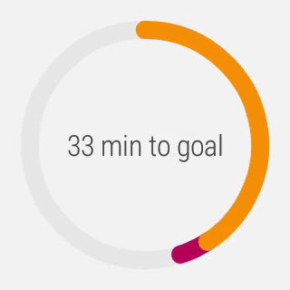

Slide 12
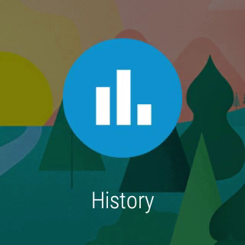

Slide 13


Slide 14
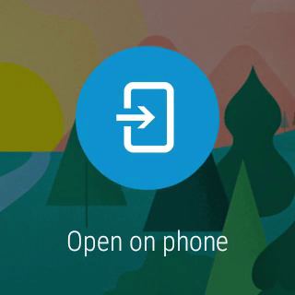

Slide 15
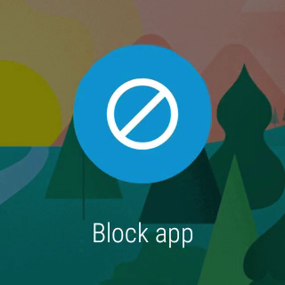

Slide 16
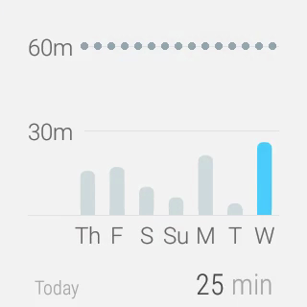

Slide 17
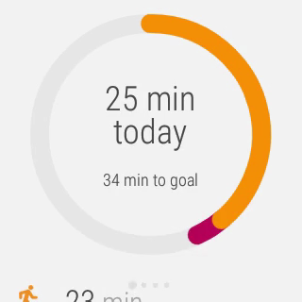

Slide 19

Creative vision

Slide 20
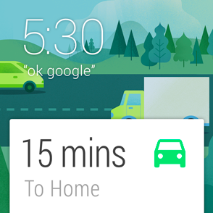
Launched automatically
Cards appear on the stream when they become relevant
“Android Wear is timely, relevant and very specific.”
Notes:
“Android Wear is timely, relevant and very specific.”

Slide 21
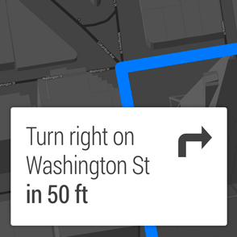
Glanceable
See information in a split second
“Android Wear is fast, sharp, and immediate.”
Notes:
“Android Wear is fast, sharp, and immediate.”

Slide 22
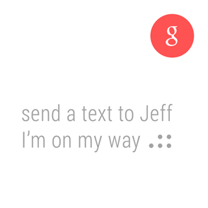
Suggest and demand
Only interrupts you when necessary and always on hand to provide an answer
“Android Wear is helpful, respectful, and responsive.”
Notes:
“Android Wear is helpful, respectful, and responsive.”

Slide 23
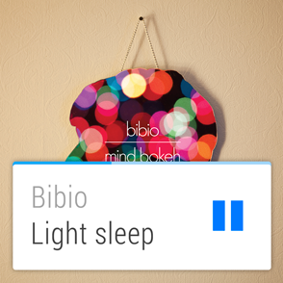
Zero or low interaction
Input rarely needed, and avoids fine-grained finger movements
“Android Wear is gestural, simple, and fast.”
Notes:
“Android Wear is gestural, simple, and fast.”

Slide 24

Under the hood

Slide 25
It’s Android
Android-powered wearable on your wrist
Running 5.0 Lollipop
Specially designed apps for Wear

Slide 26
It’s not a replacement
Connected to phone or tablet
Portal to the internet
Mirrors notifications
Requires 4.3+

Slide 27
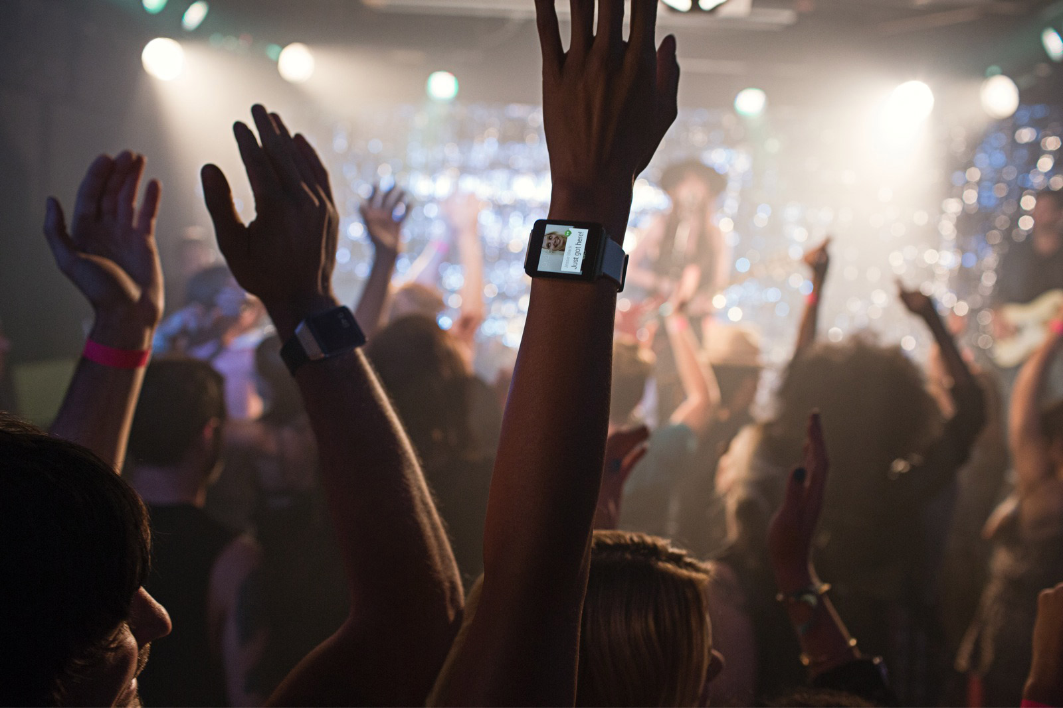
Watchfaces Notifications Wear apps

Slide 28
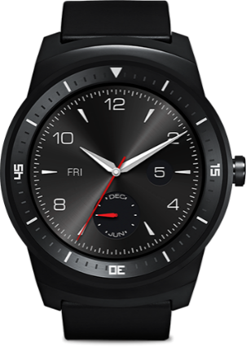
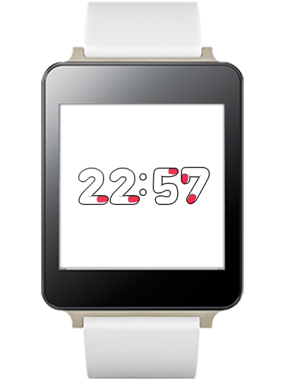
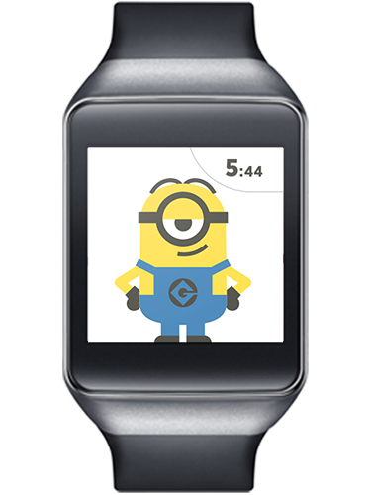
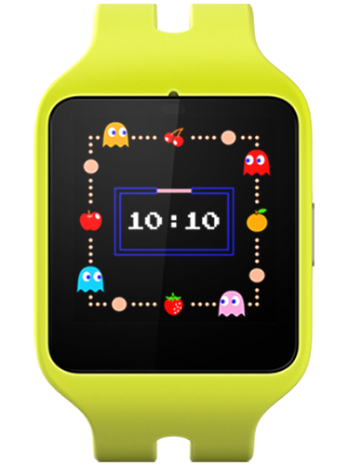
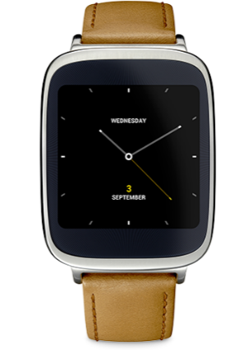
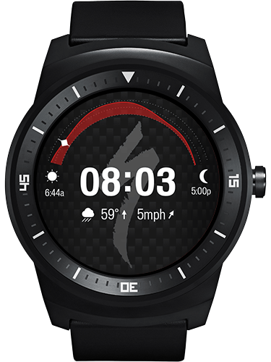
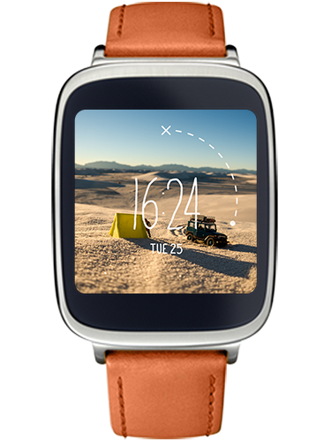
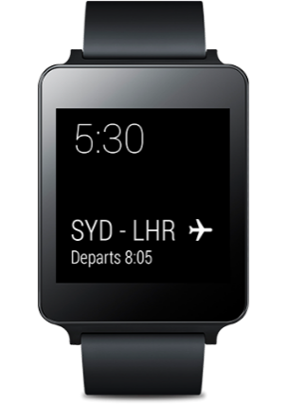
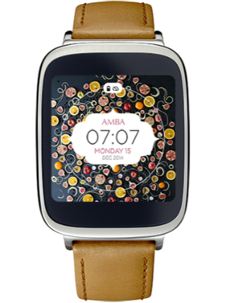
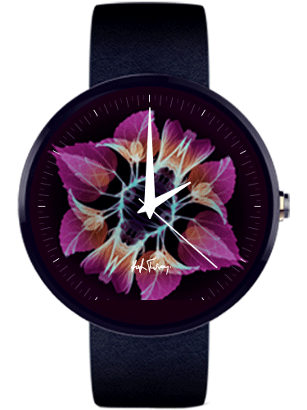
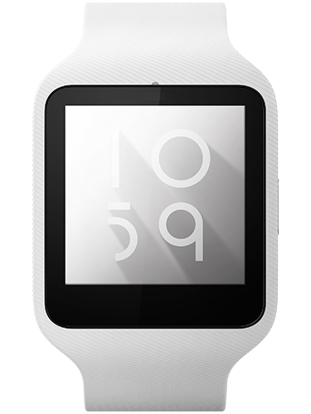
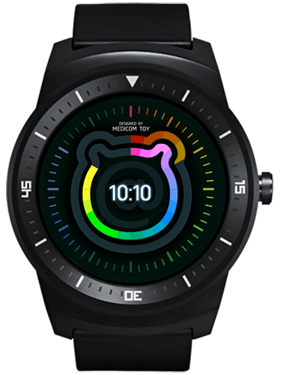
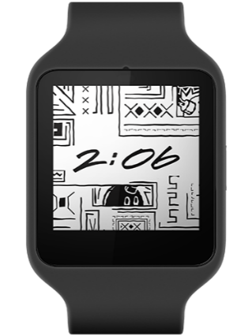
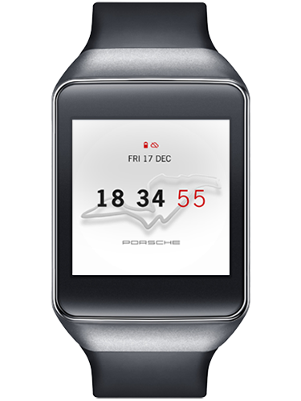
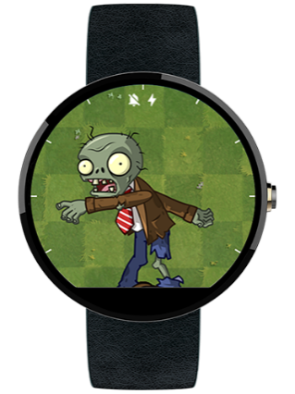
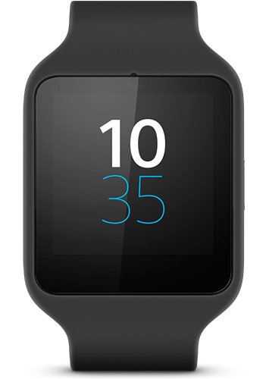
Watchfaces
Notes:
Custom watchfaces.

Slide 29
Watchfaces
Until Lollipop, no standard
Draws on a OpenGL-backed canvas inside a Service

Slide 30
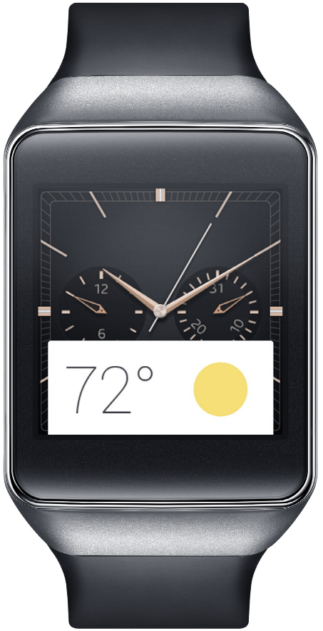
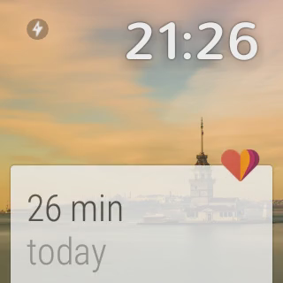
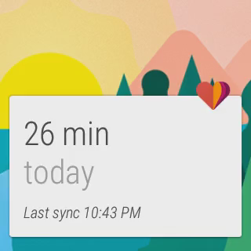
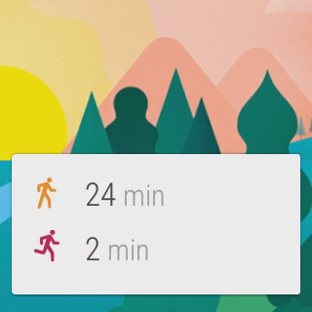
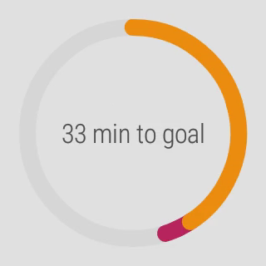
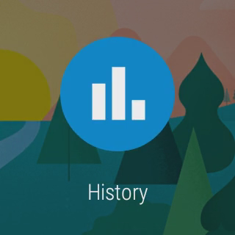
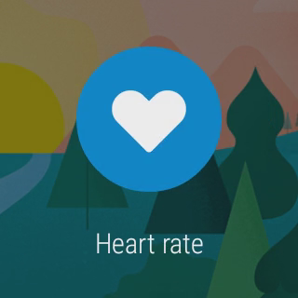
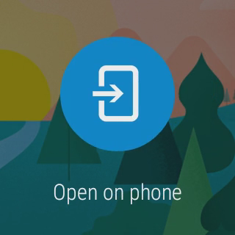
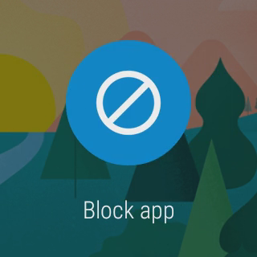
Notifications

Slide 31


Notifications
NotificationCompat works “out of the box”
}
}
}
Title, description and icon
Actions
Reserved actions

Slide 32
Notifications
Pages
DisplayIntents (requires Wear app)

Slide 33
Enriching notifications
Pages
Replying by voice

Slide 34
Enriching notifications
Voice reply
Replying by voice

Slide 35
Enriching notifications with voice reply
Add RemoteInput to Reply action
Action replyAction = new NotificationCompat.Action.Builder( R.drawable.ic_reply, getString(R.string.reply), replyPendingIntent) .addRemoteInput( new RemoteInput.Builder(EXTRA_REPLY_TEXT) .setLabel(getString(R.string.replyLabel)) .build()) .build();

Slide 36
Enriching notifications with voice reply
Modify app to use reply text
Bundle results = RemoteInput.getResultsFromIntent(intent); if (results != null) { String message = results.getString(EXTRA_REPLY_TEXT); }
Bonus: this doesn’t alter existing app behavior

Slide 37

Wear apps

Slide 38

Wear apps

Slide 39


Wear apps

Slide 40

Wear apps

Slide 41
Wear apps
Installed on the wearable
Bundled in the mobile’s APK
Inside res/raw

Slide 42
Wear apps
Included in the mobile’s build.gralde: wearApp project(':wear')
Included in the wear’s manifest: <uses-feature android:name="android.hardware.type.watch" />

Slide 43

Wear apps

Slide 44
Enriching notifications
DisplayIntents

Slide 45
Enriching notifications
DisplayIntents
Wear app must create the notification itself
DisplayIntent references an Activity and draws it
Different sizes: XSMALL, SMALL, MEDIUM, LARGE, FULL_SCREEN

Slide 46
Wear apps
APK for Wear is bundled inside the mobile’s APK
Enhanced with:
Pages
Actions
Replies
Custom backgrounds

Slide 47
Wear apps
http://developer.android.com/design/wear/principles.html
http://developer.android.com/design/wear/structure.html

Slide 48


…and more!

Slide 49
Debugging
Attach the watch via USB
Enable debugging on the wearable:
Tap the home screen twice to bring up the Wear menu.
Scroll to the bottom and tap Settings.
Scroll to the bottom and tap the Developer Options. If there's no Developer Options item, tap About, and then tap the build number 7 times.
Enable ADB debugging.

Slide 50

Debugging
Approve your computer’s RSA signature in the pop-up on your phone

Slide 51
Debugging over Bluetooth
Enable Bluetooth debugging on the wearable:
Tap the home screen twice to bring up the Wear menu.
Scroll to the bottom and tap Settings.
Scroll to the bottom and tap the Developer Options. If there's no Developer Options item, tap About, and then tap the build number 7 times.
Enable Debug over Bluetooth.

Slide 52
Debugging over Bluetooth
Connect the handheld to your machine over USB
Run: adb forward tcp:4444 localabstract:/adb-hub adb connect localhost:4444
Approve your computer’s RSA signature in the pop-up on your phone

Slide 53
Tips
Use a common project to share constants between your wear and handheld

Slide 54
Gotchas!
Properly packaging a wearable app
Declare the wearable app module in the handheld app: wearApp project(':wearable')
The handheld and wearable apps have the same
Package name
Version number
All permissions declared in the wearable app must also be declared in the handheld app
Sign both apps and assemble the release variant

Slide 55
Gotchas!
Turn off asset compression
The wearable app is located in res/raw
It’s already compressed
Any other installation problems
Look at the PackageUpdateService tag in Logcat

Slide 56
Useful stuff

Slide 57


Added value

Slide 58
Wear′s the Party!
Source code & slides: http://github.com/Pixplicity/weardemo
Paul Lammertsma
CTO, Pixplicity
@officesunshine

